Slide 2
ASP.NET Core 3.0 Development Using Mac
Shailendra Chauhan
Microsoft MVP, Founder and CEO DotNetTricks

Slide 3
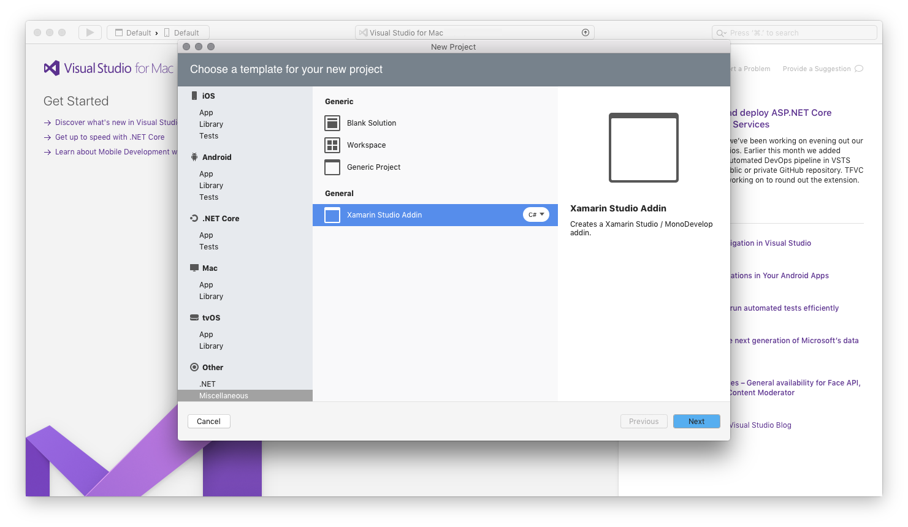
Visual Studio 2019 For Mac

Slide 4
Evolution of ASP.NET Core
Active Server Pages
(Classic ASP)
ASP.NET
Web Forms
1/2/3.5/4
/4.5/4.6/4.7
ASP.NET
MVC
1/2/3/4/5
ASP.NET
MVC 6
Core MVC
1/1.1/2/2.1/2.2/3.0
Unified MVC, Web API and Web Pages
ASP.NET
Web Pages
1/2/3
ASP.NET
Web API
1/2

Slide 5



ASP.NET Core 3.0 Architecture
ASP.NET 4.X
WebForms/MVC, WCF
ASP.NET Core 3.0, WebHooks, SignalR
ML/AI
IoT
Universal Windows Apps
WPF, Windows Forms (Windows Only)
.NET Framework 4.6+
.NET Core 3.0
Common
Runtime Components
Compilers
NuGet packages
Next gen JIT (RyuJIT)
SIMD
Languages innovation
.NET Compiler Platform
.NET Core Libraries
.NET Framework 4.6 Libraries

Slide 6
ASP.NET Core Anatomy
Everything starts from Program.cs, Main Method
ASP.NET Core apps require a Startup class
No more Global.asax
No more Web.Config requirement
No more modules and handlers
Cross-platform Kestrel web server

Slide 7
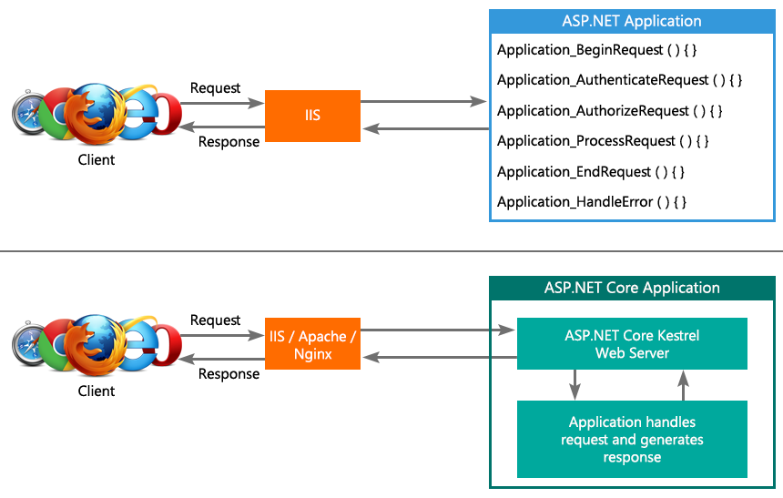
ASP.NET and ASP.NET Core Request Processing

Slide 8
Demo: Getting Started with ASP.NET Core 3.0 using Mac

Slide 9
Questions and Answers

Slide 10
Thank you for joining us!

